Slide 1
Introduction to Software Architecture
Lecturer: Ngo Huy Bien
Software Engineering Department
Faculty of Information Technology
VNUHCM - University of Science
Ho Chi Minh City, Vietnam
nhbien@fit.hcmus.edu.vn

Slide 2

Objectives
To explain what software architecture is.
To explain why software architecture is important.
To communicate in the field of software architecture.

Slide 3

Contents
Software Architecture
Architectural Representation
Architecture Design Method
Architecture Reconstruction
Architecture Benefits
Architecture Evaluation

Slide 4

References
Frank Buschmann et al. (1996). Pattern-Oriented Software Architecture: A System Of Patterns. John Wiley & Sons Ltd book.
David Garlan and Mary Shaw (1994). An Introduction to Software Architecture.
Klaus Pohl et al. (2005). Software Product Line Engineering - Foundations, Principles, and Techniques.
Len Bass, Paul Clements and Rick Kazman (2021). Software Architecture in Practice. Addison-Wesley.
Robert Cloutier et al. (2010). The Concept of Reference Architectures.
Philippe Kruchten (2009). Documentation of Software Architecture from a Knowledge Management Perspective – Design Representation.
Philippe Kruchten (1995). Architectural Blueprints - The 4+1 View Model of Software Architecture.
Craig Larman (2004). Applying UML And Patterns. 3rd Edition. Prentice Hall.
Nick Rozanski and Eoin Woods (2012). Software Systems Architecture: Working with Stakeholders Using Viewpoints and Perspectives. Addison-Wesley Professional.
Robert C. Martin (2017). Clean Architecture: A Craftsman’s Guide to Software Structure and Design. Pearson Education.

Slide 5
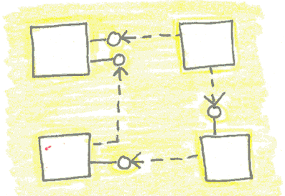
What is Software Architecture? [1]
A software architecture is a description of the subsystems and components of a software system and the relationships between them.
The software architecture of a system is an artifact.
It is the result of the software design activity.
It is a solution to a problem.
Therefore we need a problem first.
→ Functionality, quality attributes.

Slide 6
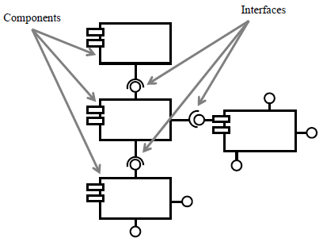
Component
A component is an encapsulated part of a software system.
A component has an interface.
Components serve as the building blocks for the structure of a system.
At a programming-language level, components may be represented as modules, classes, objects or a set of related functions.

Slide 7
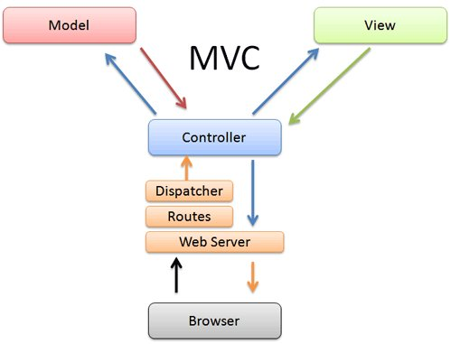
Relationship
A relationship denotes a connection between components.
A relationship may be static or dynamic.
Static relationships show directly in source code.
They deal with the placement of components within an architecture.
Dynamic relationships deal with temporal connections and dynamic interaction between components.
They may not be easily visible from the static structure of source code.

Slide 8
What is Software Architecture? [2]
An architecture of a specific system is a collection of computational components — or simply components — together with a description of the interactions between these components — the connectors.
This leads to a view of an abstract architectural description as a graph in which the nodes represent the components and the arcs represent the connectors.
Connectors can represent interactions as varied as procedure call, event broadcast, database queries, and pipes.

Slide 9
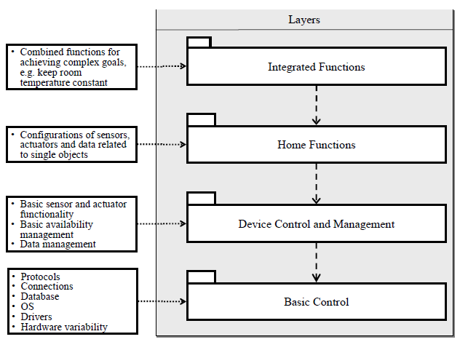
What is Software Architecture? [3]
The architectural structure is the decomposition of a software system into parts and relationships.
The architectural texture is the collection of common development rules for realizing the system.
Structure in Home Automation

Slide 10
Texture in Home Automation
The use of layering in the structure, as described in Structure.
The use of a hierarchy of layers, subsystems, and components as described in Structure.
The facade pattern that demands a single interface at subsystem level.
The observer pattern, which decouples user interface issues from the data.
The presence of an initialization interface with a prescribed set of functions at each component.
The use of high-priority processes for user interface handling an medium-priority processes for user functions.

Slide 11

What is Software Architecture? [4]
The software architecture of a program or computing system is the structure or structures of the system, which comprise software elements, the externally visible properties of those elements, and the relationships among them.
An architecture is foremost an abstraction of a system that suppresses details of elements that do not affect how they use, are used by, relate to, or interact with other elements.
Every computing system with software has a software architecture.
An architecture can exist independently of its description or specification.
The behavior of each element is part of the architecture.
The definition is indifferent as to whether the architecture for a system is a good one or a bad one.

Slide 12
Other Points of View
Architecture is high-level design.
Other tasks associated with design are not architectural, such as deciding on important data structures that will be encapsulated.
Architecture is the overall structure of the system.
The multiplicity of structures in an architecture lies at the heart of the concept.
Architecture is the structure of the components of a program or system, their interrelationships, and the principles and guidelines governing their design and evolution over time.
Any system has an architecture that can be discovered and analyzed independently of any knowledge of the process by which the architecture was designed or evolved.
Architecture is components and connectors.
Connectors imply a runtime mechanism.
When we speak of "relationships" among elements, we intend to capture both runtime and non-runtime relationships.

Slide 13
Reference Models
A reference model is a division of functionality together with data flow between the pieces.
A reference model is a standard decomposition of a known problem into parts that cooperatively solve the problem.
Arising from experience, reference models are a characteristic of mature domains.
Can you name the standard parts of a compiler or a database management system?
Can you explain in broad terms how the parts work together to accomplish their collective purpose?
If so, it is because you have been taught a reference model of these applications.

Slide 14
Reference Architecture
A reference architecture is a reference model mapped onto software elements (that cooperatively implement the functionality defined in the reference model) and the data flows between them.
Whereas a reference model divides the functionality, a reference architecture is the mapping of that functionality onto a system decomposition.
The mapping may be, but by no means necessarily is, one to one. A software element may implement part of a function or several functions.

Slide 15
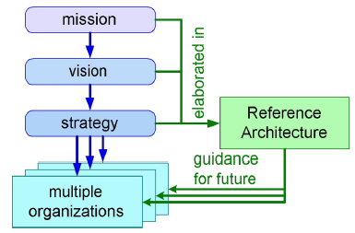
What is Reference Architecture? [5]
A reference architecture is an elaboration of company (or consortium) mission, vision, and strategy.
Such reference architecture facilitates a shared understanding across multiple products, organizations, and disciplines about the current architecture and the vision on the future direction.

Slide 16
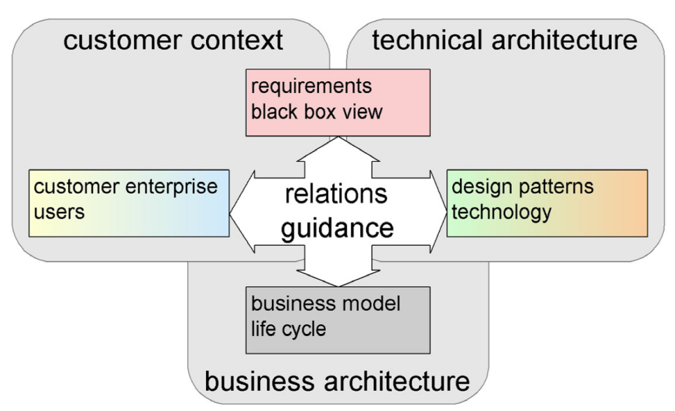
Reference Architecture Elements
Reference architecture is largely based on the explicit understanding of the relations between the business architecture, the technical architecture, and the customer context.
In practice, business architecture and customer context are often missing. As a consequence, these technical Reference Architectures represent solutions for unspecified problems in unspecified contexts.
Business architecture, technical architecture and customer
context together form the Reference Architecture.

Slide 17
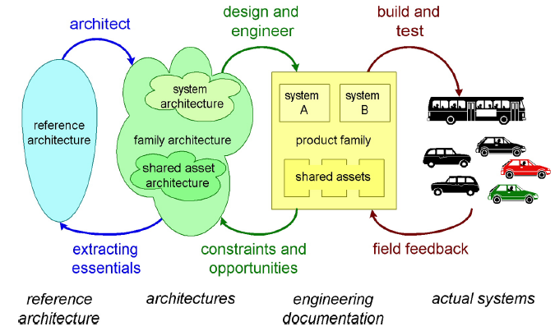
Reference Architecture Abstraction Level

Slide 18
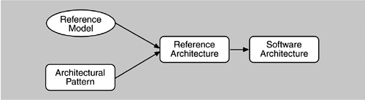
Relationship [4]
Reference models, architectural patterns, and reference architectures are not architectures; they are useful concepts that capture elements of an architecture.
Each is the outcome of early design decisions.
The relationships of reference models, architectural patterns, reference architectures, and software architectures.
(The arrows indicate that subsequent concepts contain more design elements.)

Slide 19


Slide 20
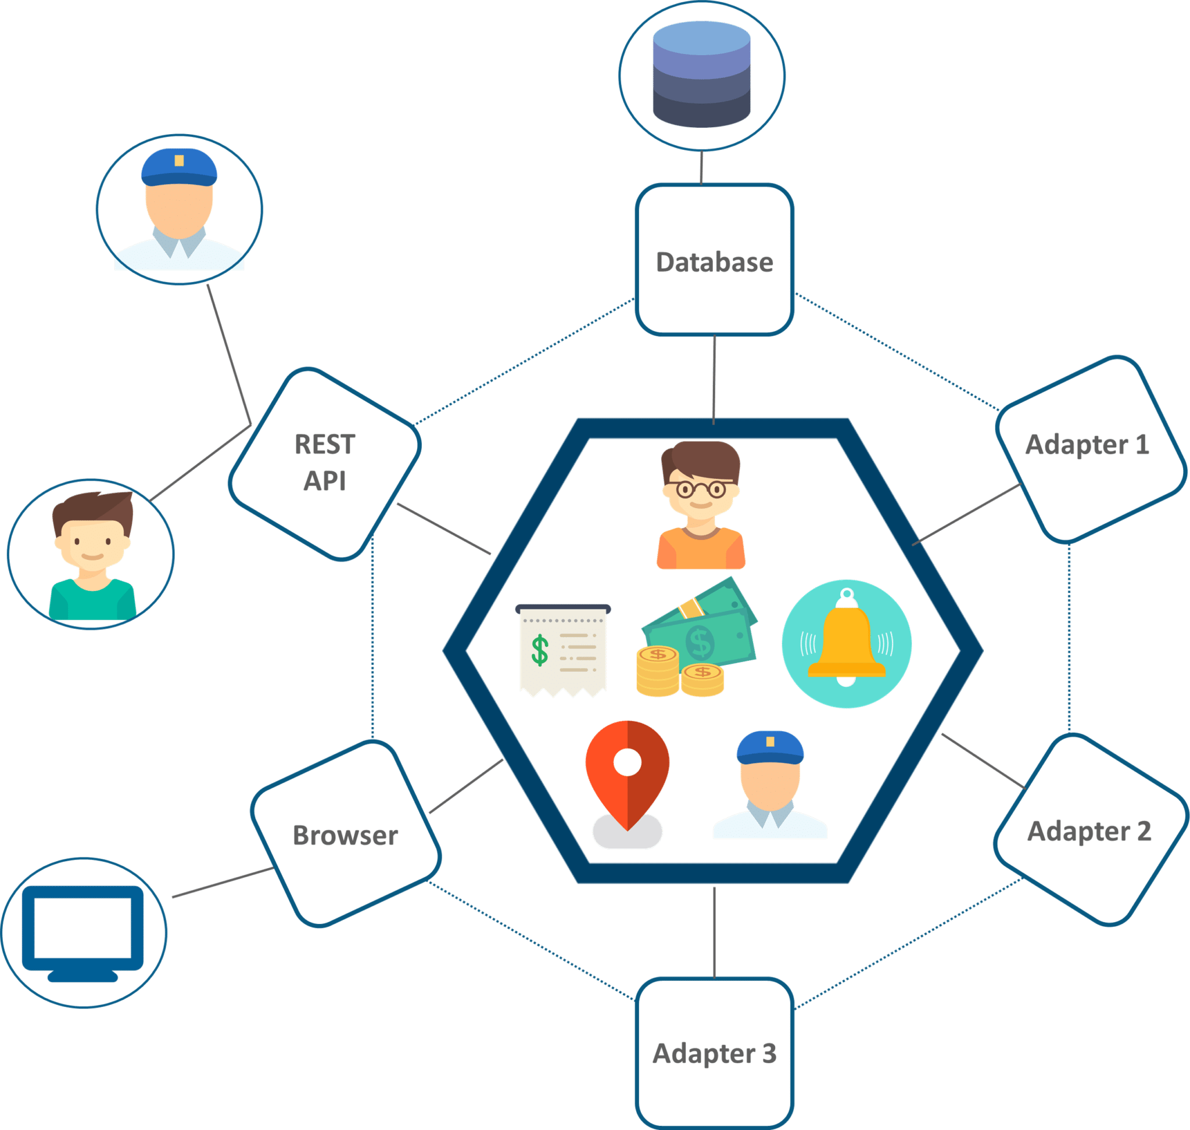
Architectural Representation I: Boxes and Arrows [6]
Not much precise semantics behind the boxes and the arrows.
Still very valuable in bridging the gaps between various groups of stakeholders.

Slide 21
Architectural Representation II: Architecture Description Languages
What ADLs have in common is that they are able to
denote essential elements of an architecture – components, package,
as well as the relationship between these components: connectors, interfaces, and
to a certain extent some of the characteristics and behavior of these components and connectors –
so that some form of analysis, verification, and reasoning can occur, to derive or assess completeness, consistency, ambiguity, performance, and other qualities.
ADLs often offer both a textual and a graphical notation, the intention being to have them readable by both humans and machines.

Slide 22
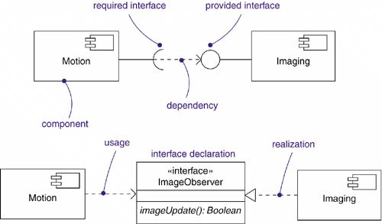
Architectural Representation III: UML

Slide 24
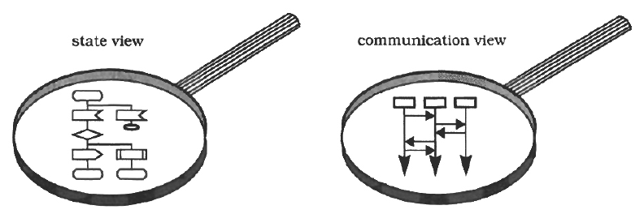
Model and View [1, 6]
A model is a simplification of reality, an abstraction of a system, created to better understand the system.
A view represents a partial aspect of a software architecture that shows specific properties of a software system.
A view is a projection of a model, which is seen from one perspective or vantage point and omits entities that are not relevant to this perspective.
Views represent the interests of different stakeholders.

Slide 25
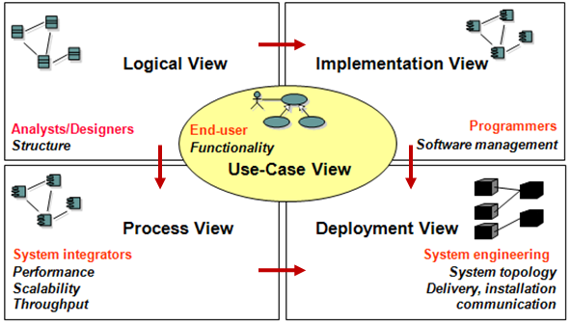
The 4+1 View Model [7]
Logical view represents functional components and their relationships.
Development view focuses on software modules, packages, and environments used.
Process view shows a system’s performance, scalability, workflow rules.
Physical view considers how software is mapped to hardware.

Slide 26
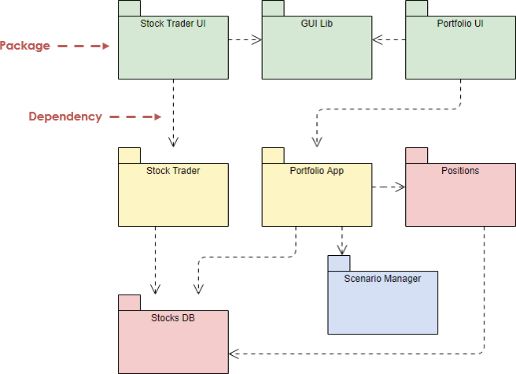
The Logical View [8]
The logical architecture is the large-scale organization of the software classes into packages (or namespaces), subsystems, and layers.
This view is called functional view.
It describes the functional characteristics of the software.

Slide 27
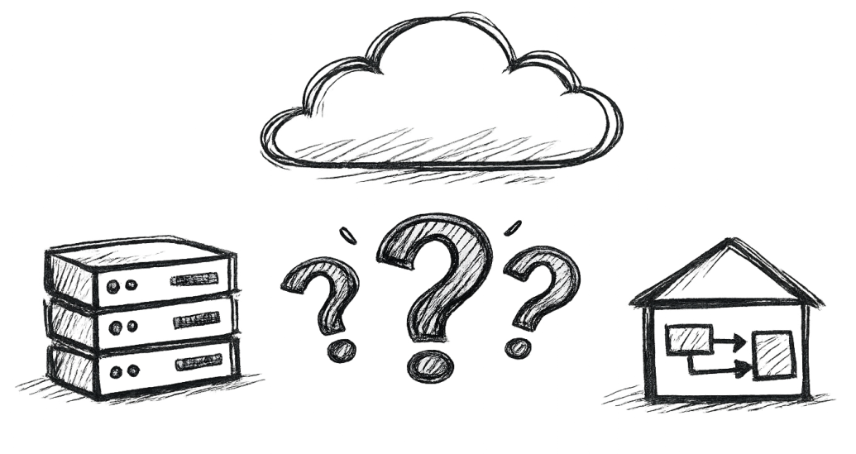
Logical View Questions
What are the components and subcomponents?
What are the relationships between the components?
Which languages and technologies will be used to implement each component?

Slide 28
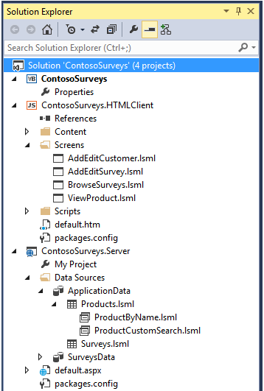
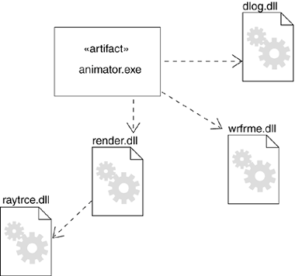
The Development View
This view describes how the software is organized into modules or compilation units during the development process.

Slide 29
Development View Questions
What source code folders and files correspond to each component and subcomponent?
What are the steps to build the source code?
What are the steps to run the source code?

Slide 30
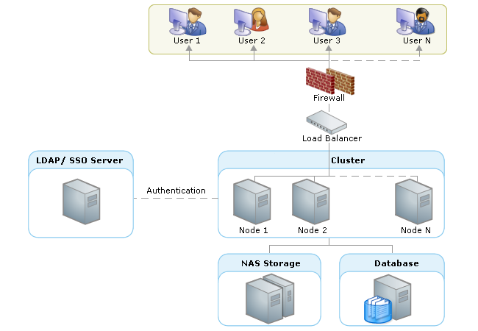
The Deployment View
The software's static organization in its deployment environment.
This view shows the deployment of software elements to the physical architecture and the communication (usually on a network) between physical elements.
A deployment diagram shows the assignment of concrete software artifacts (such as executable files) to computational nodes (something with processing services).

Slide 31
Deployment View Questions
What deployment artifacts are produced?
How is each component deployed?
What outputs are generated by the deployment of each component?
How are the components integrated with one another?

Slide 32
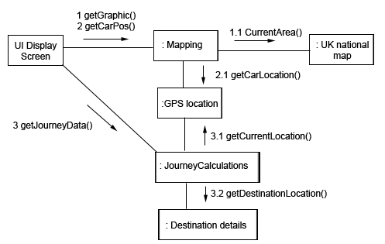
The Process View
The process architecture takes into account some non-functional requirements, such as performance and availability.
It addresses issues of concurrency and distribution, of system’s integrity, of fault-tolerance, and how the main abstractions from the logical view fit within the process architecture — on which thread of control is an operation for an object actually executed.
At the highest level, the process architecture can be viewed as a set of independently executing logical networks of communicating programs (called “processes”), distributed across a set of hardware resources connected by a LAN or a WAN.

Slide 33
Process View Questions
Which components are involved in feature X?
What are the inputs and outputs of each communication step?

Slide 34
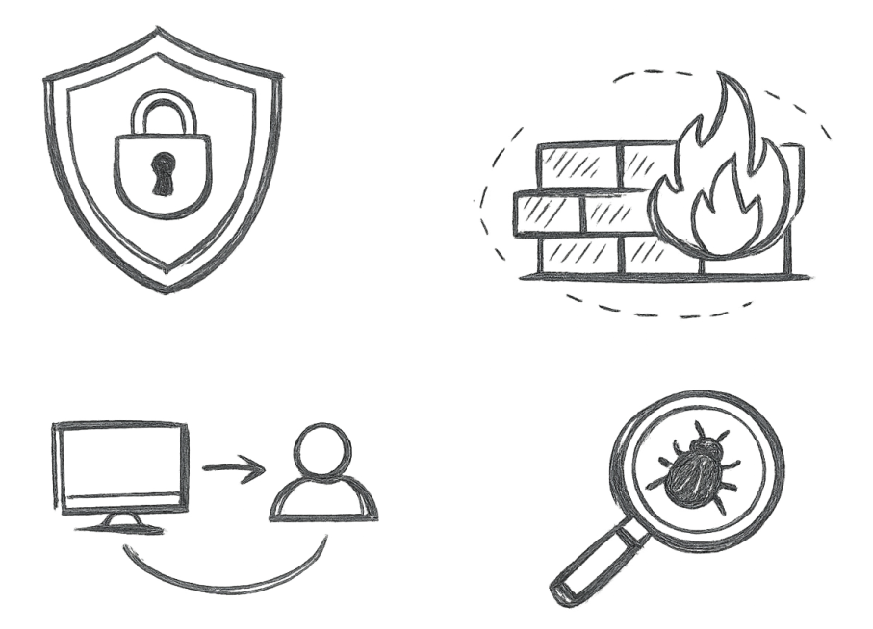
Security View

Slide 35
Security View Questions
Which components are responsible for security concerns?
Which languages and technologies are used to implement each component?
What checkpoints are defined for authentication and authorization?

Slide 36
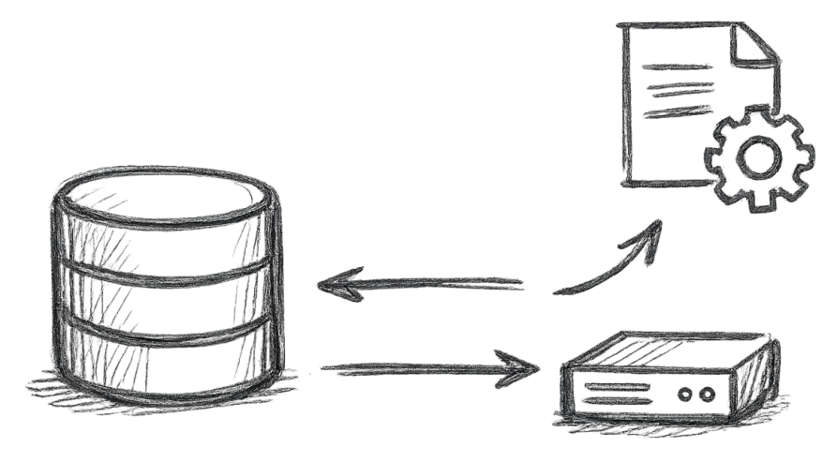
Persistence View

Slide 37
Persistence View Questions
Which data must be saved, and what are their meanings?
What are the tables, objects, or files, and what are their relationships?
What are the table columns or object fields?

Slide 38
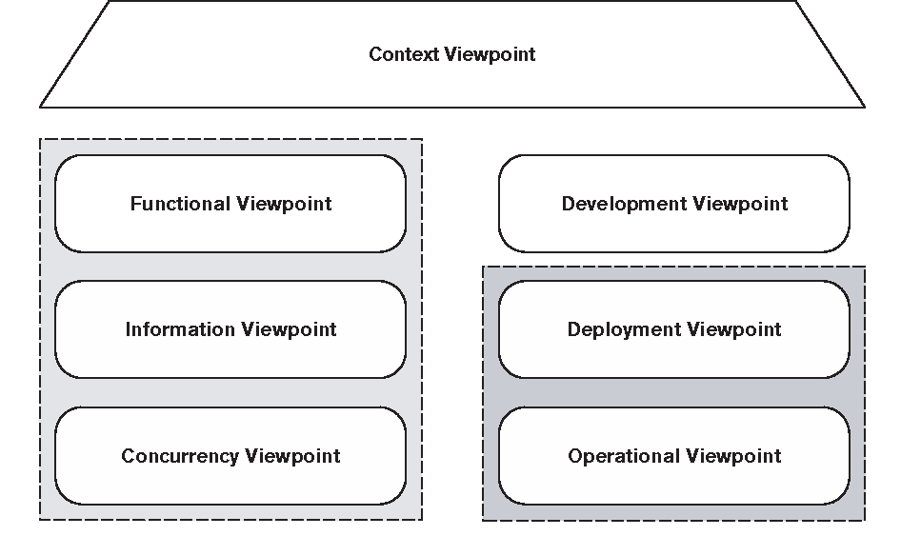
Viewpoints [9]
It would be hard work if every time you were creating a view of your architecture you had to go back to first principles to define what should go into it.
A viewpoint is a collection of patterns, templates, and conventions for constructing one type of view. It defines the stakeholders whose concerns are reflected in the viewpoint and the guidelines, principles, and template models for constructing its views.

Slide 39
Documenting Architecture: {Elements, Form, Rationale} [6]
Architecture = {Elements, Form, Rationale}
The elements are the main constituents of any architectural description in terms of components and connectors, while the nonfunctional properties guide the final shape or form of the architecture.
There are several benefits of using design rationales in architecture as a mean to explain why a particular design choice is made or to know which design alternatives have been evaluated before the right or the optimal design choices are made.

Slide 40
Documenting Architecture: Architectural Knowledge
Architectural Knowledge = Architectural Design + Architectural Design Decisions
Architectural Design
Viewpoints and Views
Architecture Description Languages
Application-Generic Knowledge: Patterns, Standards, Frameworks
Architectural Design Decisions
Epitome (or the Decision itself). This is a short textual statement of the design decision, a few words or a one liner. This text serves to summarize the decisions, to list them, to label them in diagrams.
Rationale. This is a textual explanation of the “why” of the decision, its justification. If the rationale is expressed in a complete external document, for example, a tradeoff analysis, then the rationale points to this document.
Scope. Some decisions may have limited scope, in time, in the organizations, or in the design and implementation.

Slide 42
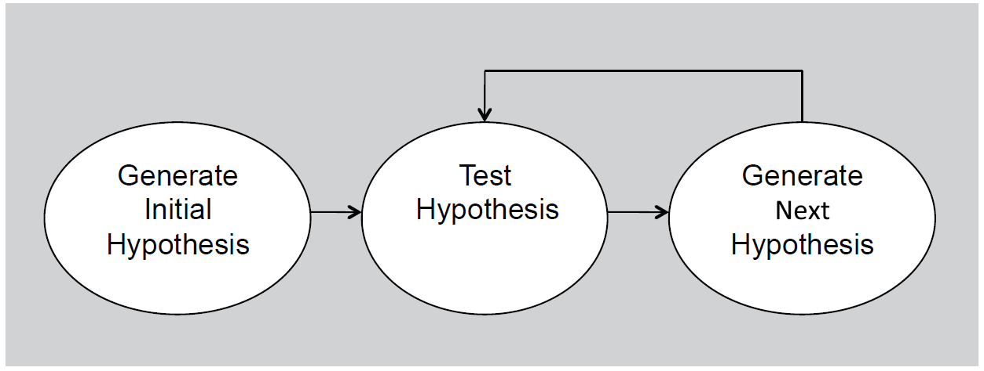
Architecture Design Method [4]
System Context Diagram, System Decomposition
Designing to Architecturally Significant Requirements
Generate and Test
Where does the initial hypothesis come from?
Styles, Patterns, Standards, and Frameworks

Slide 43
Architecture Reconstruction

Slide 45


Why Software Architecture?
Every computing system with software has an architecture.
The code is the truth, but it is often too complicated.
Simpler version of resolution of a problem (modularization and information hiding)
A vehicle for communication among the system’s stakeholders.
Analysis of suitability of design decisions
Reusable assets

Slide 46



Why Software Architecture?
Your money, not that of investors.
Cost Estimation
Buy vs. Build

Slide 47
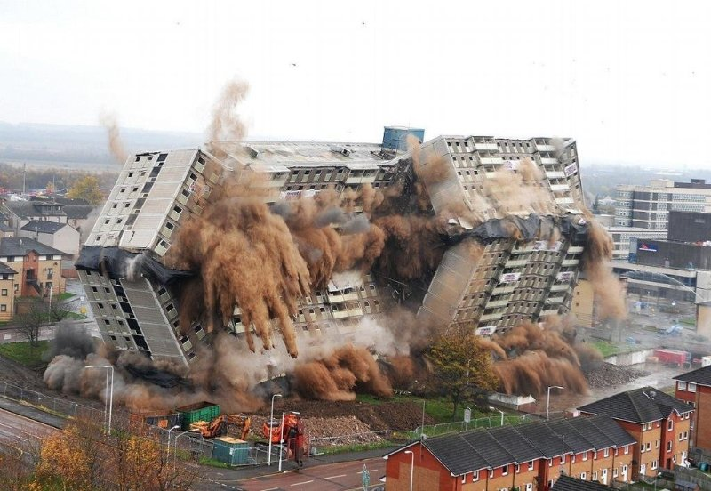
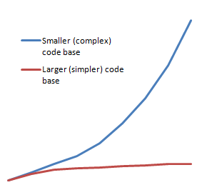
But, Actually Why Software Architecture? [10]
The size and complexity of software systems increase.
The models are much cheaper than the real thing we are building.
Human lives

Slide 48
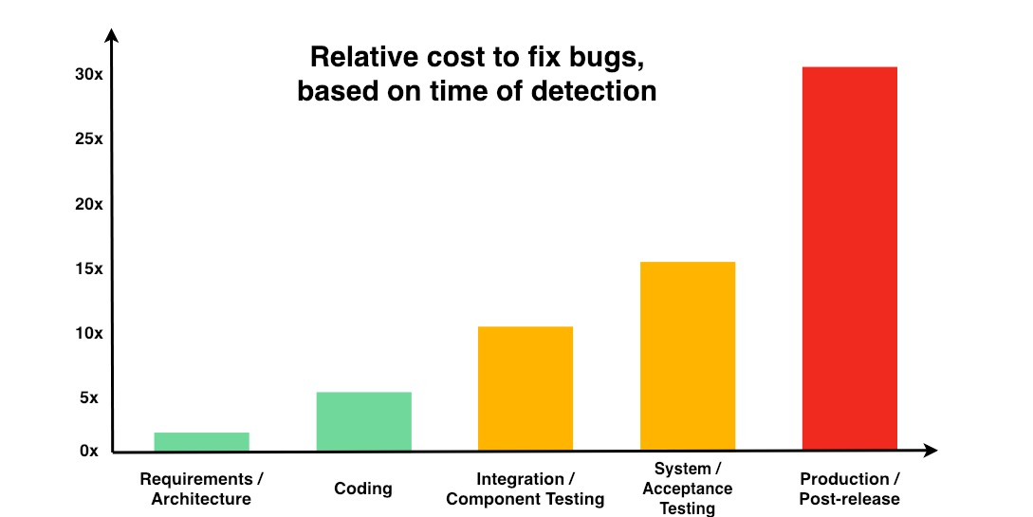
The Cost of Wrong Architecture
Exponential cost of fixing bugs (Source: NIST).

Slide 50

“Good” Architecture (I)
Development time reduction
Implementable (business cases support).
Understandability
Screaming (expressing its core business purpose)
Modular.
Independent UI. The UI can change easily.
Independent of any external agency.
Independent of the database and frameworks.
The business rules can be tested without the UI,
database, web server, or any other external element.
Deployment time reduction
Units of deployment (DLLs, JARs, PHP files, gem files) are few.
Deployed with a single action.

Slide 51
“Good” Architecture (II)
Maintenance time reduction (changes and extensibility effort reduction)
Independent of frameworks.
Independent of any external agency.
Independent of the database.
Plug-in architecture
Understandability
Screaming (expressing its core business purpose)
(Optional) Operational feasibility
Scalability

Slide 52

Evaluate an Architecture
How to map requirements to components?
How to construct each component? Which technology can be used to construct each component?
How to organize, build and integrate components?
How to implement scenarios based on the proposed components?
How to deploy, operate and replace a component?
How to scale a component?

Slide 53
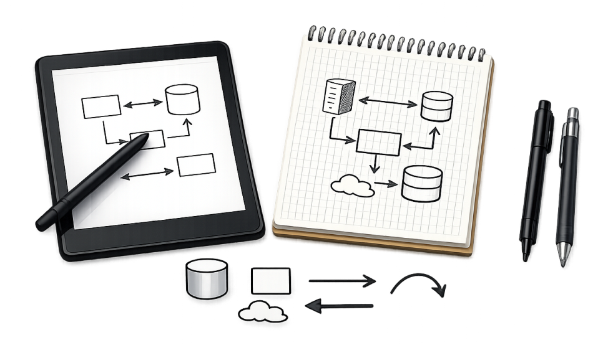
Tools
https://app.diagrams.net/
https://lucid.app/

Slide 54

Thank You & See You Again

